Slide 1
6. Registers and Counters

Slide 2
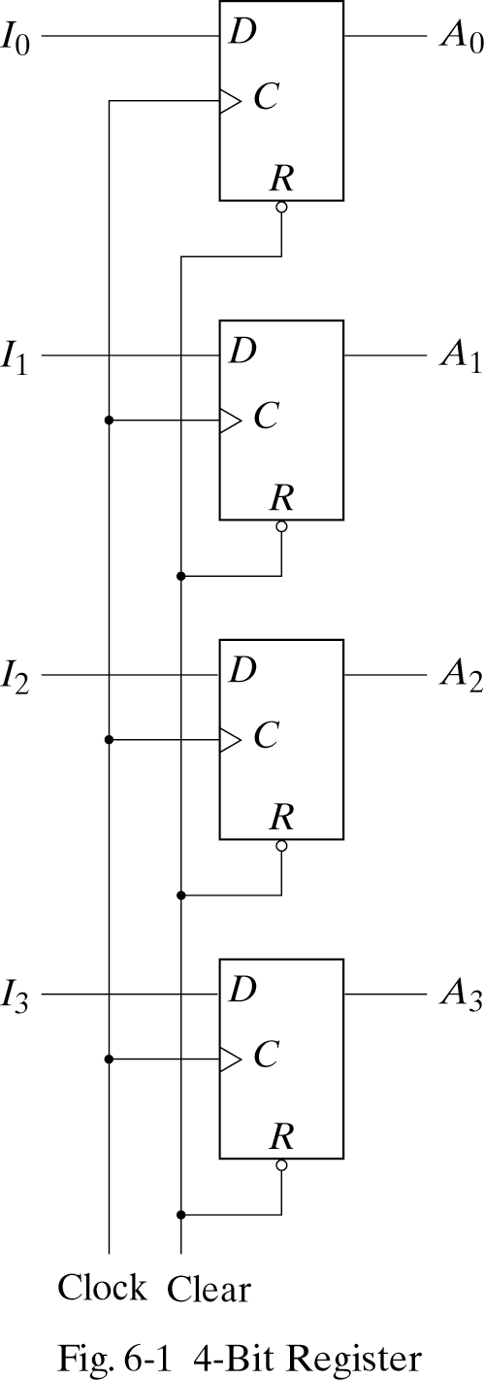
6.1 REGISTERS
Register- a group of binary cells suitable for holding binary information.
Clock=1 ;input information transferred
Clock=0 ;unchanged
Clear=0 ;clearing the register to all 0’s prior to its clocked operation.

Slide 3
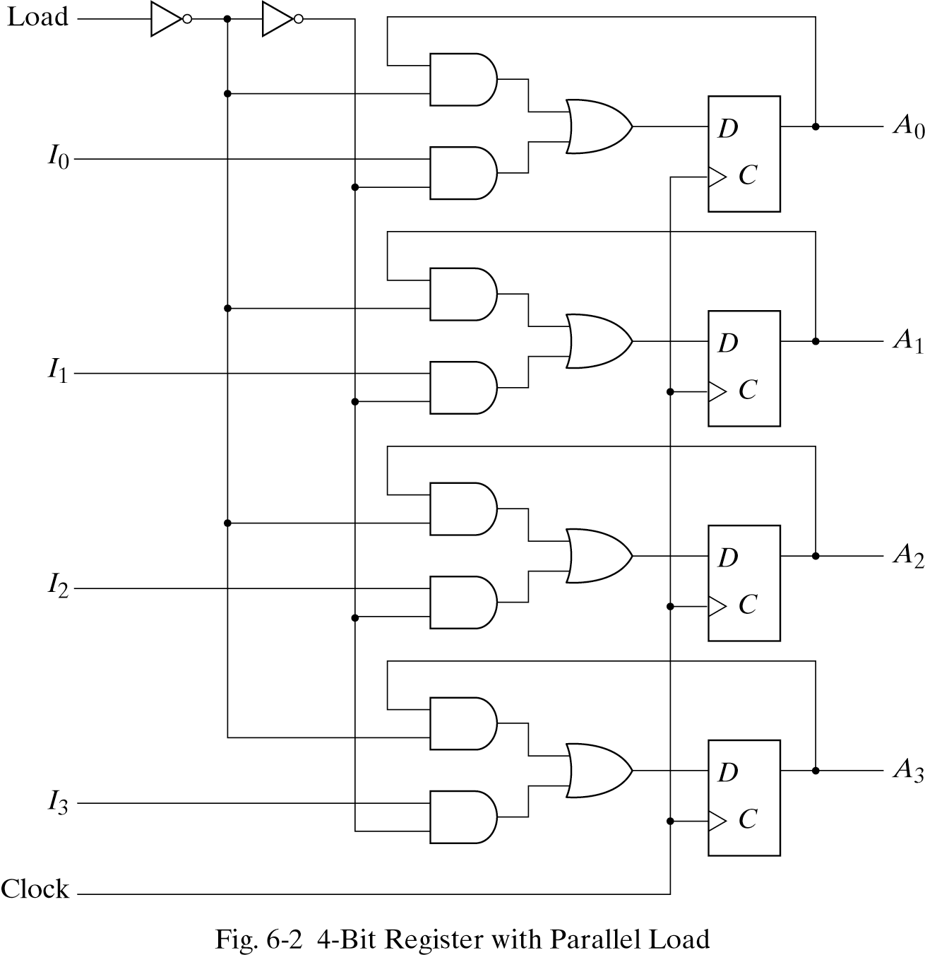
6.1 REGISTERS - Register with Parallel Load
Clock=1 ;input information
->loading
Clock=0 ;the content of the register ->unchanged
Load input=1 ; the I inputs are transferred into the register
Load input=0 ; maintain the content of the register

Slide 4
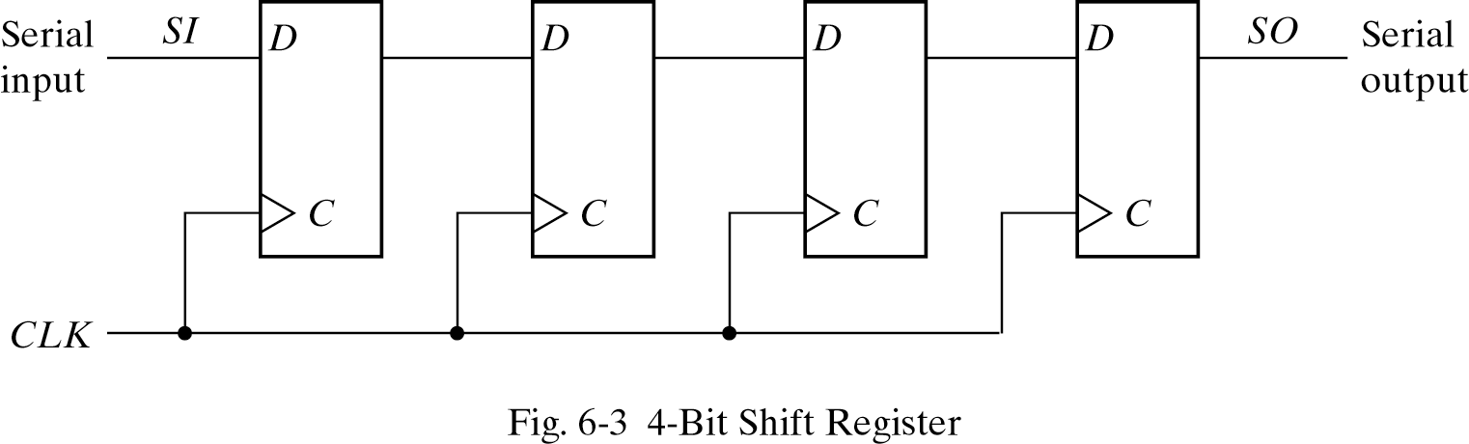
6.2 SHIFT REGISTERS
Shift register-capable of shifting its binary information in one or both directions
The simplest shift register

Slide 5
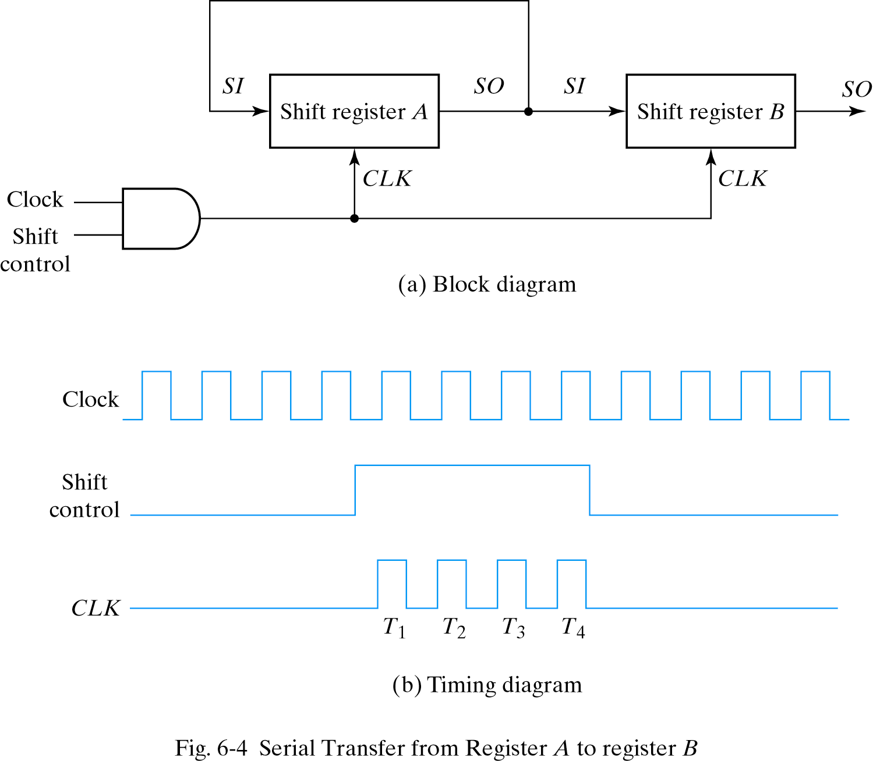
6.2 SHIFT REGISTERS - Serial Transfer
To prevent the loss of information stored in the source register

Slide 6
6.2 SHIFT REGISTERS - Serial Transfer
Serial-Transfer Example
Timing pulse
Initial value
Shift register A
Shift register B
Serial output of B
1 0 1 1
0 0 1 0
0
After T1
After T2
1 1 0 1
1 1 1 0
1 0 0 1
1 1 0 0
1
0
0
After T3
After T4
0 1 1 1
1 0 1 1
0 1 1 0
1 0 1 1
1

Slide 7
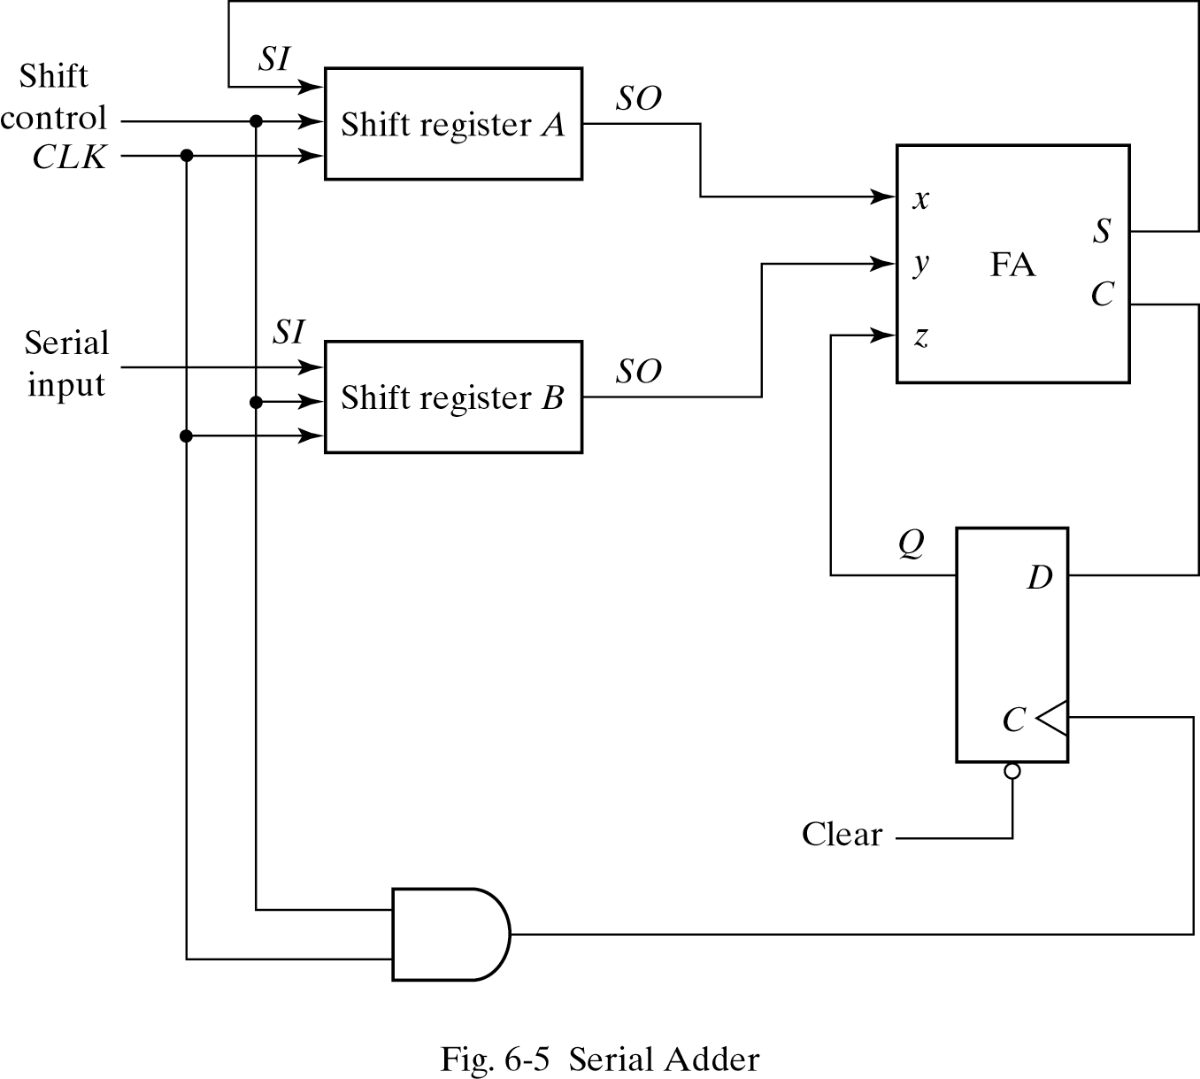
6.2 SHIFT REGISTERS - Serial Addition
For storing sum
Operation
the A register ->augend ,the B register ->addend ,carry ->0
The SO of A and B provide a pair of significant bits for the FA
Output Q gives the input carry at z
The shift-right control enables both registers and the carry flip-flop.
The sum bit from S enters the leftmost flip-flop of A

Slide 8
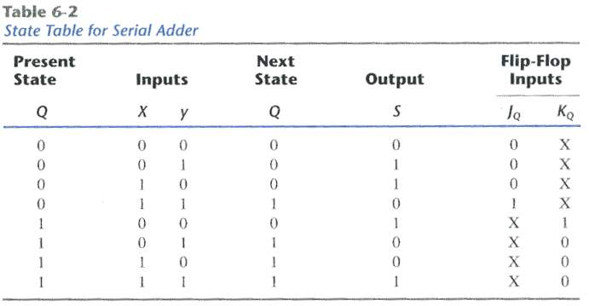
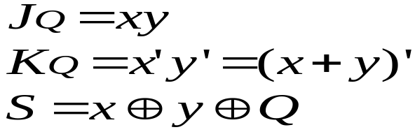
6.2 SHIFT REGISTERS - State Table for Serial Adder
Present value of carry
Output carry
By k-map

Slide 9
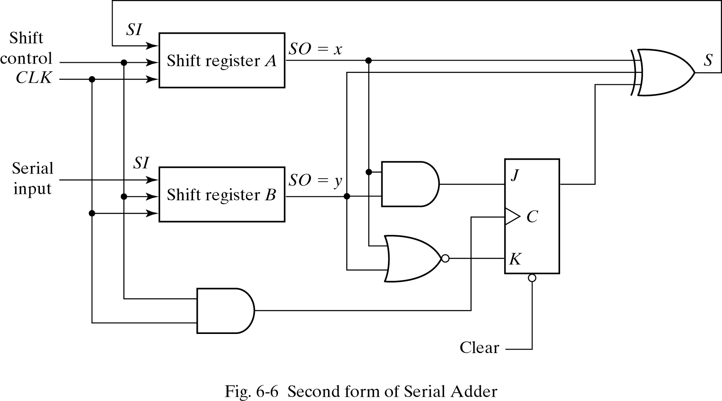
6.2 SHIFT REGISTERS - Second form of Serial Adder

Slide 10
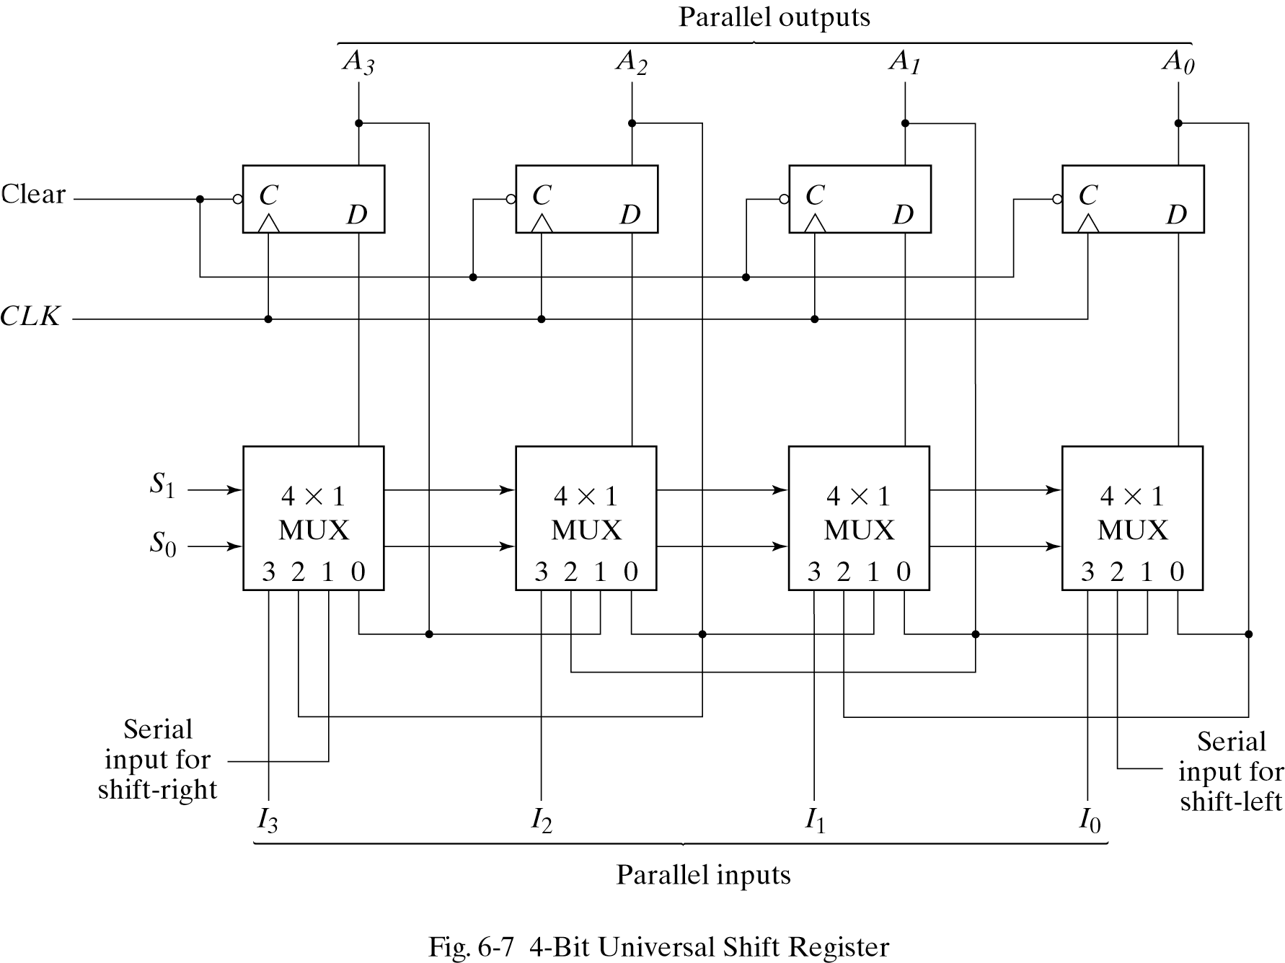
6.2 SHIFT REGISTERS - Second form of Serial Adder
Universal Shift Register
S1, S0 -> 0, 0 ;No change
S1, S0 -> 0, 1 ;Shift right
S1, S0 -> 1, 0 ;Shift left
S1, S0 -> 1, 1 ;Parallel load

Slide 11
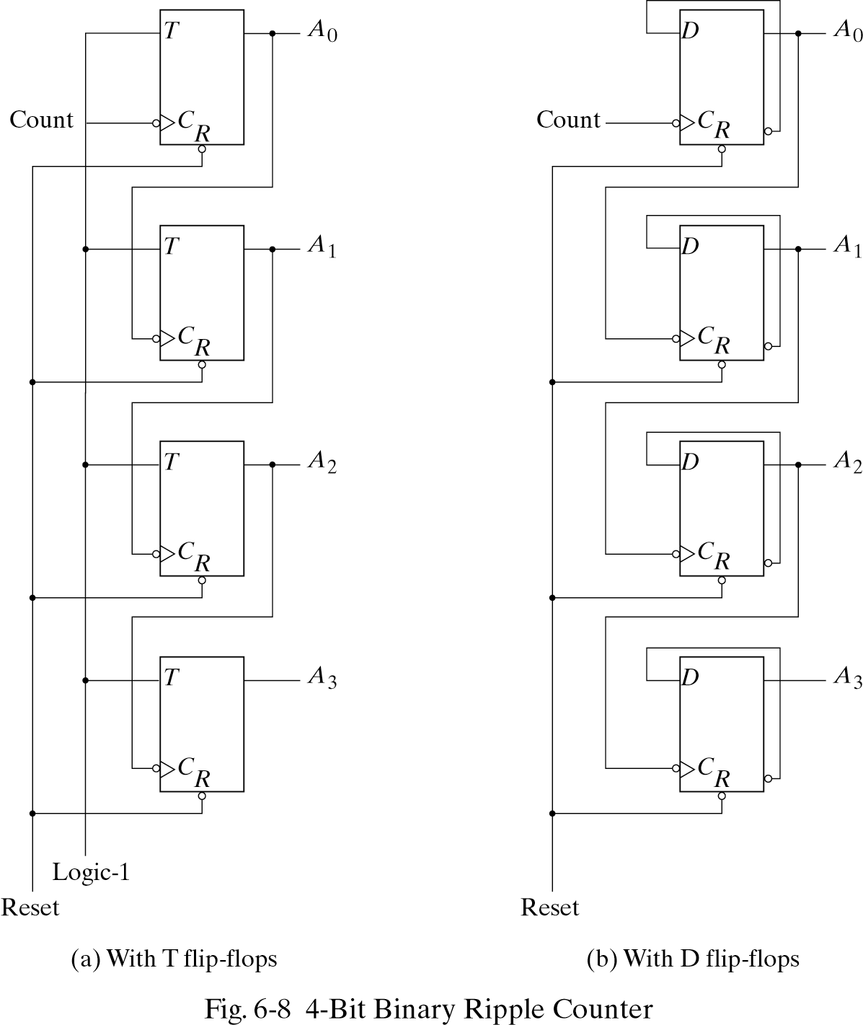
6.3 RIPPLE COUNTERS
LSB

Slide 12
6.3 RIPPLE COUNTERS - Binary Ripple Counter
Count sequence A3 A2 A1 A0 |  | Conditions for Complementing
0 0 0 0 0 0 0 1 0 0 1 0 0 0 1 1 0 1 0 0 0 1 0 1 0 1 1 0 0 1 1 1 ……………… 1 0 0 0 | Complement A0 Complement A0 Complement A0 Complement A0 Complement A0 Complement A0 Complement A0 Complement A0 and so on… | A0 will go from 1 to 0 and complement A1 A0 will go from 1 to 0 and complement A1 ; A1will go from 1 to 0 and complement A2 A0 will go from 1 to 0 and complement A1

Slide 13
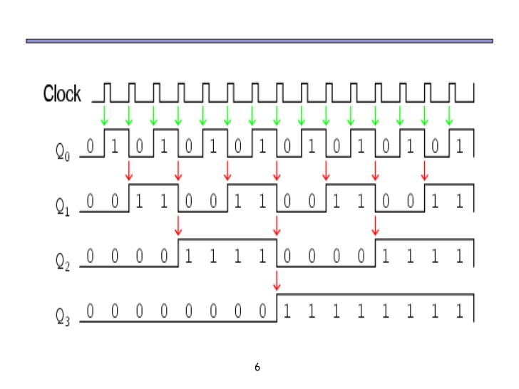
6.3 RIPPLE COUNTERS
https://www.slideshare.net/LeeDiaz2/counters-11983921

Slide 14
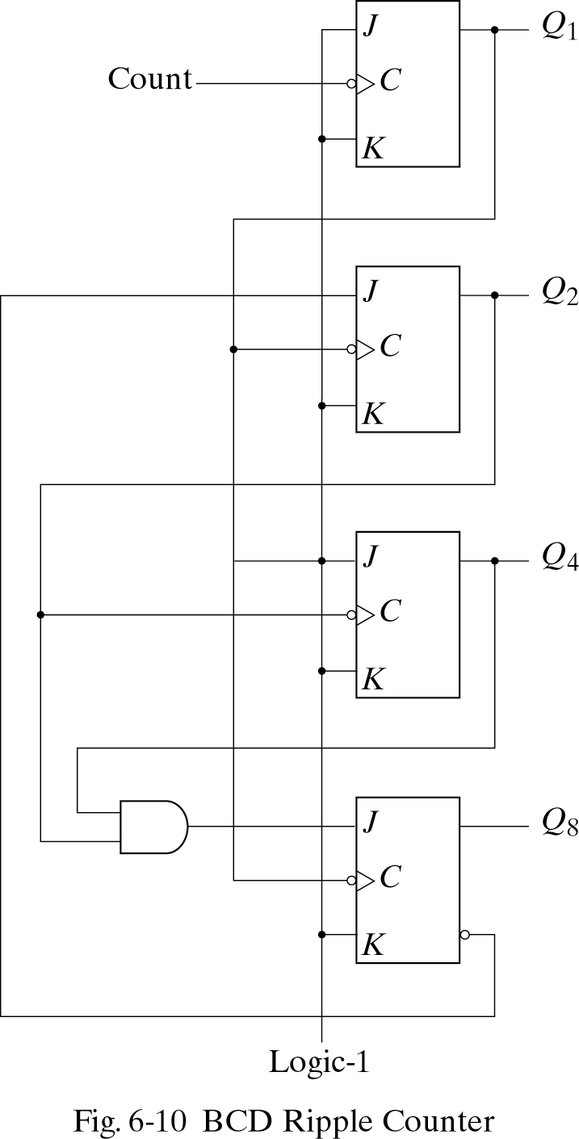
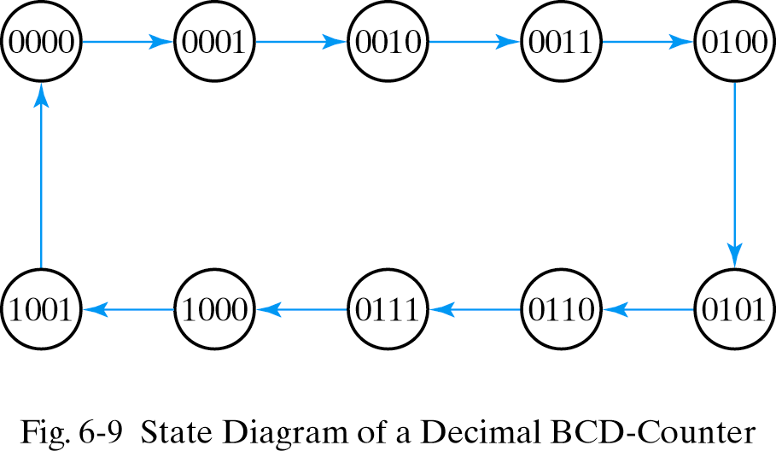
6.3 RIPPLE COUNTERS - BCD Ripple Counter

Slide 15
6.3 RIPPLE COUNTERS - BCD Ripple Counter
Operation
1. Q1 is complemented on the negative edge of every count pulse.
2. Q2 is complemented if Q8=0 and Q1 goes from 1 to 0. Q2 is cleared if Q8=1 and Q1 goes from 1 to 0.
3. Q4 is complemented when Q2 goes from 1 to 0.
4 .Q8 is complemented when Q4Q2=11 and Q1 goes from 1 to 0. Q8 is cleared if either Q4 or Q2 is 0 and Q1 goes from 1 to 0

Slide 16
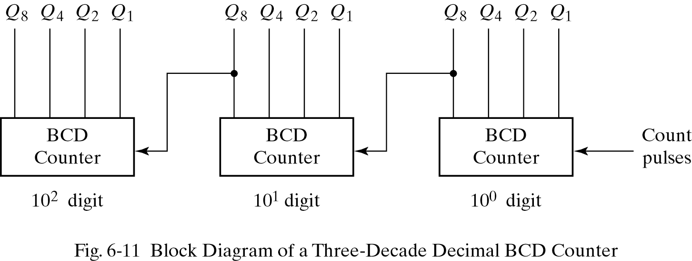
6.3 RIPPLE COUNTERS - BCD Ripple Counter
Three-Decade Decimal BCD Counter
To count from 0 to 999, We need a three-decade counter.

Slide 17
6.4 SYNCHRONOUS COUNTERS
Synchronous Counters
  Binary Counter
  Up-Down Binary Counter
  BCD Counter
  Binary Counter with Parallel Load
  Other Counter

Slide 18
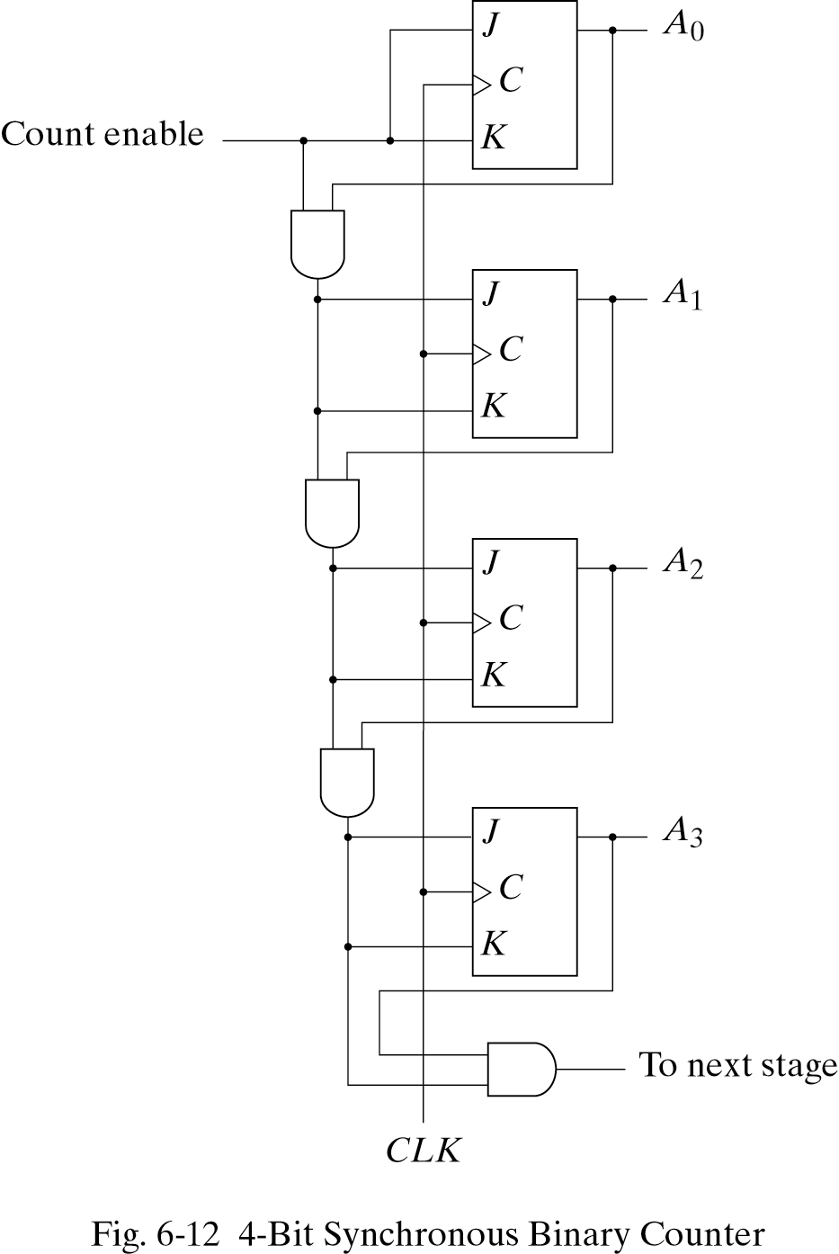
6.4 SYNCHRONOUS COUNTERS - Binary Counter
The first stage A0 has its J and K equal to 1 if the counter is enabled .
The other J and K inputs are equal to 1 if all previous low-order bits are equal to 1 and the count is enabled.

Slide 19
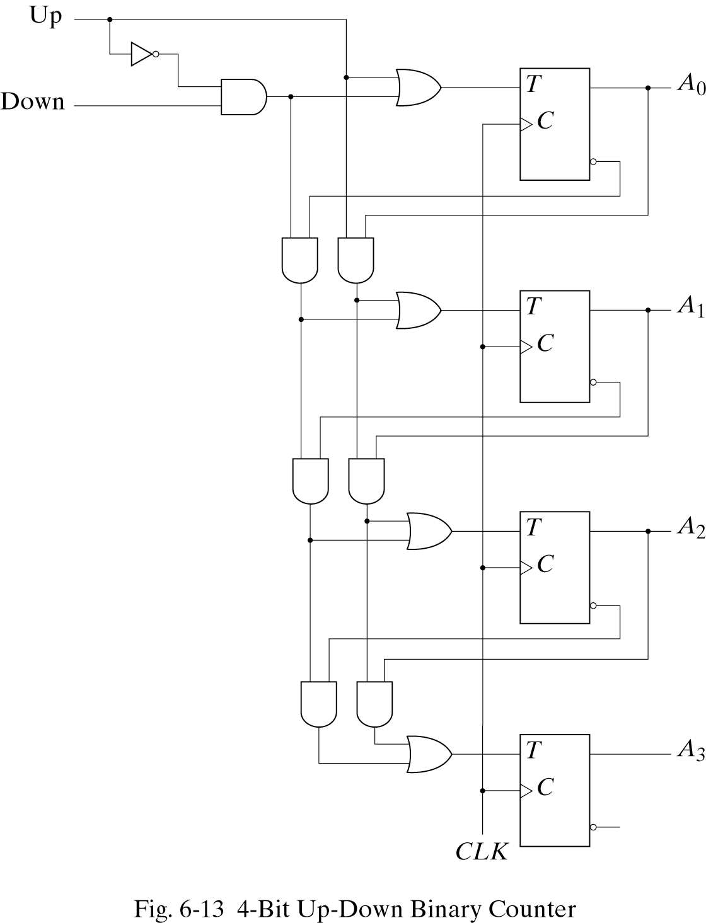
6.4 SYNCHRONOUS COUNTERS - Up-Down Binary Counter
Up input control=1 ;count up (the T inputs receive their signals from the values of the previous normal outputs of the flip-flops.)
Down input control=1, up input control=0 ; count down
Up=down=0 ;unchanged state
Up=down=1 ;count up

Slide 20
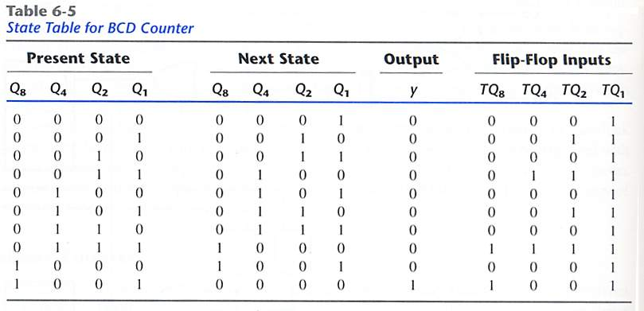
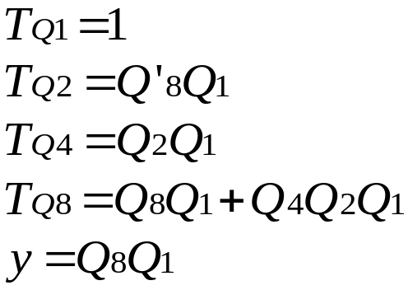
6.4 SYNCHRONOUS COUNTERS - BCD Counter

Slide 21
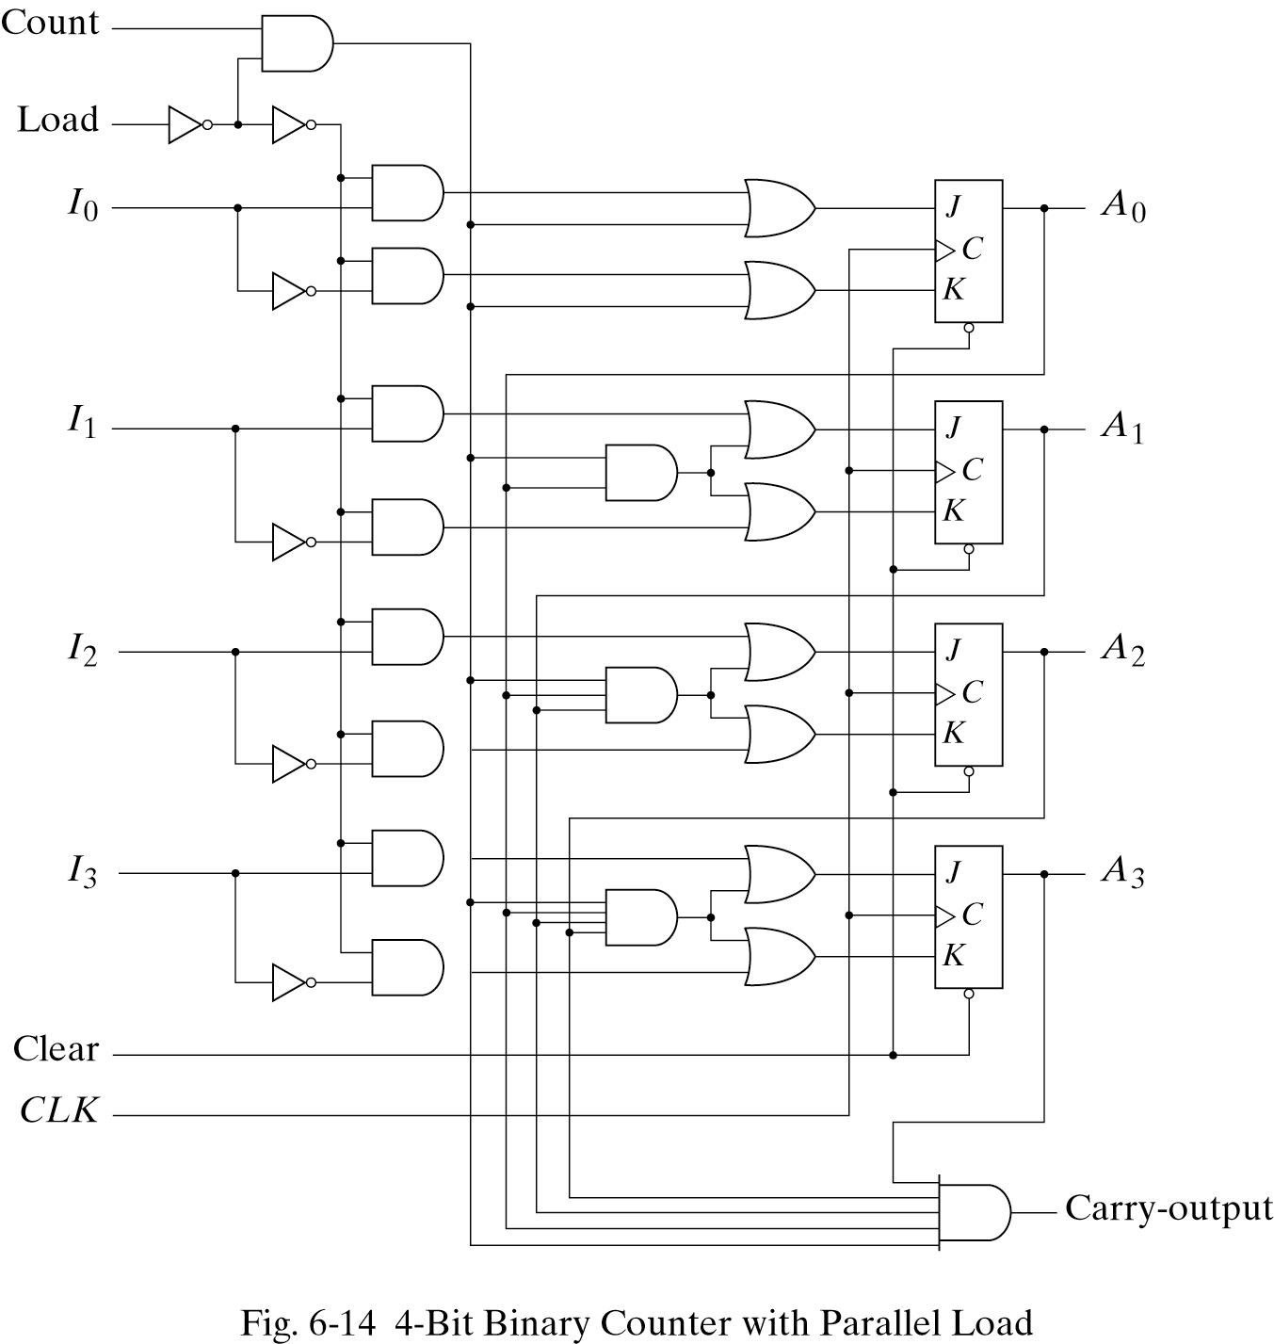
6.4 SYNCHRONOUS COUNTERS - Binary Counter with Parallel Load
Input load control=1 ; disables the count sequence ,data transfer
Load =0 and count=1 ;count
Load=0 and count=0 ;unchanged
Carry out=1(all flip-flop=1)

Slide 22
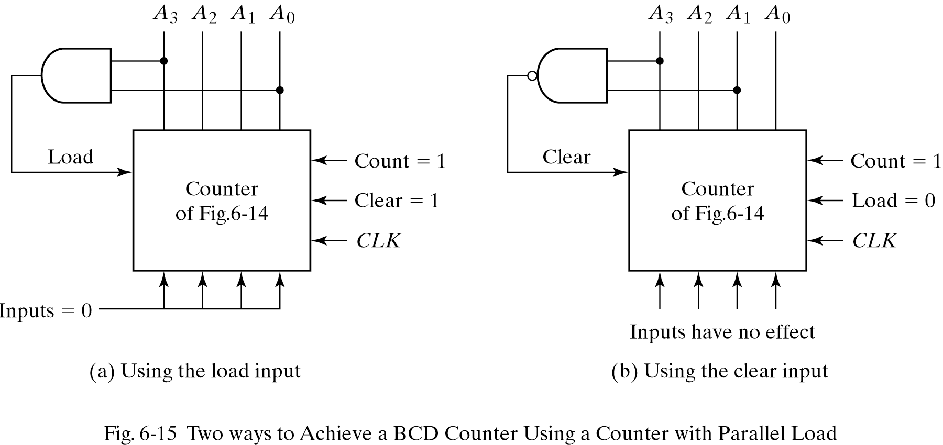
6.4 SYNCHRONOUS COUNTERS - Binary Counter with Parallel Load
BCD COUNTER using Binary Counter with Parallel Load
The AND gate detects the occurrence of state 1001(9) in the output. In this state, the load input is enabled and all-0’s input is loaded into register.
The NAND gate detects the count of 1010(10) , as soon as this count occurs the register is cleared.
A momentary spike occurs in output A2 as the count goes from 1001 to 1010 and immediately to 0000

Slide 23
6.5 OTHER COUNTERS
Counter with Unused States
  Don’t care conditional Counter
Ring Counter
Johnson Counter

Slide 24
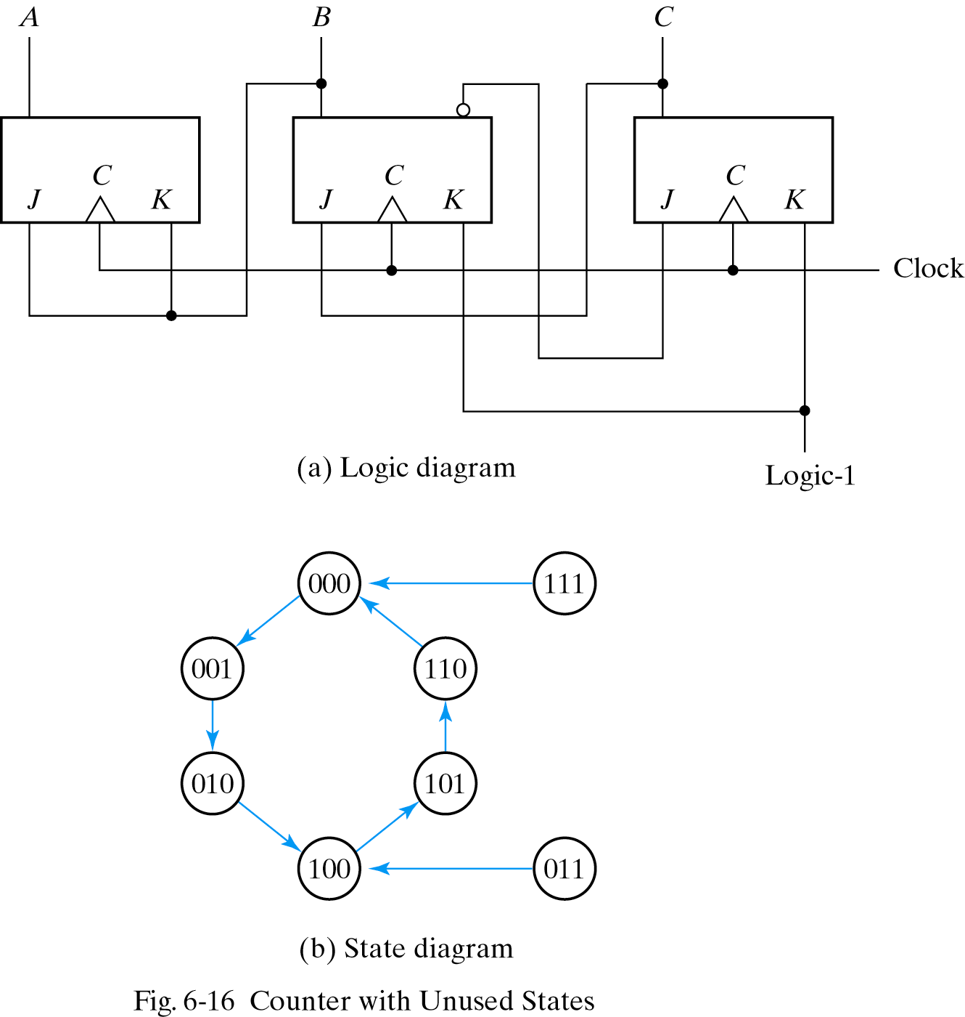
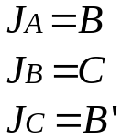
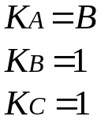
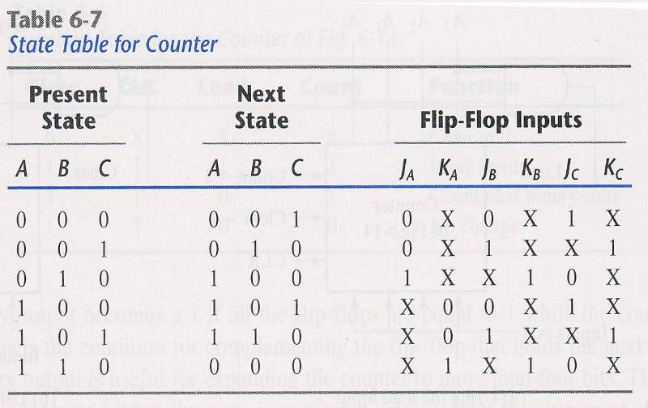
6.5 OTHER COUNTERS - Counter with Unused States
Except 011 ,111

Slide 25
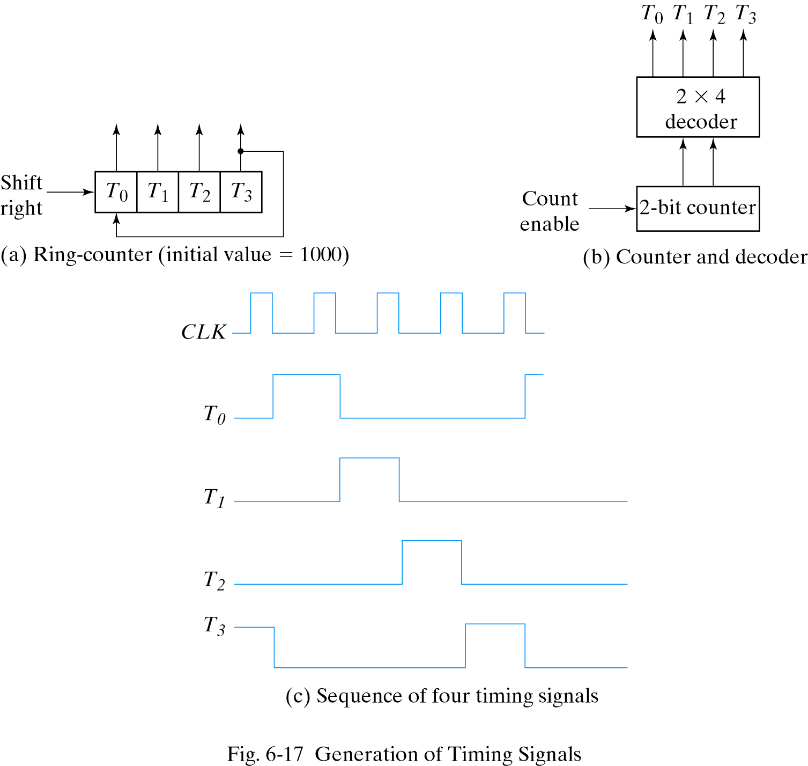
6.5 OTHER COUNTERS - Ring Counter
A circular sift register with only one flip-flop being set at any particular time. ; all others are cleared.
The single bit is shifted from one flip-flop to the other.

Slide 26
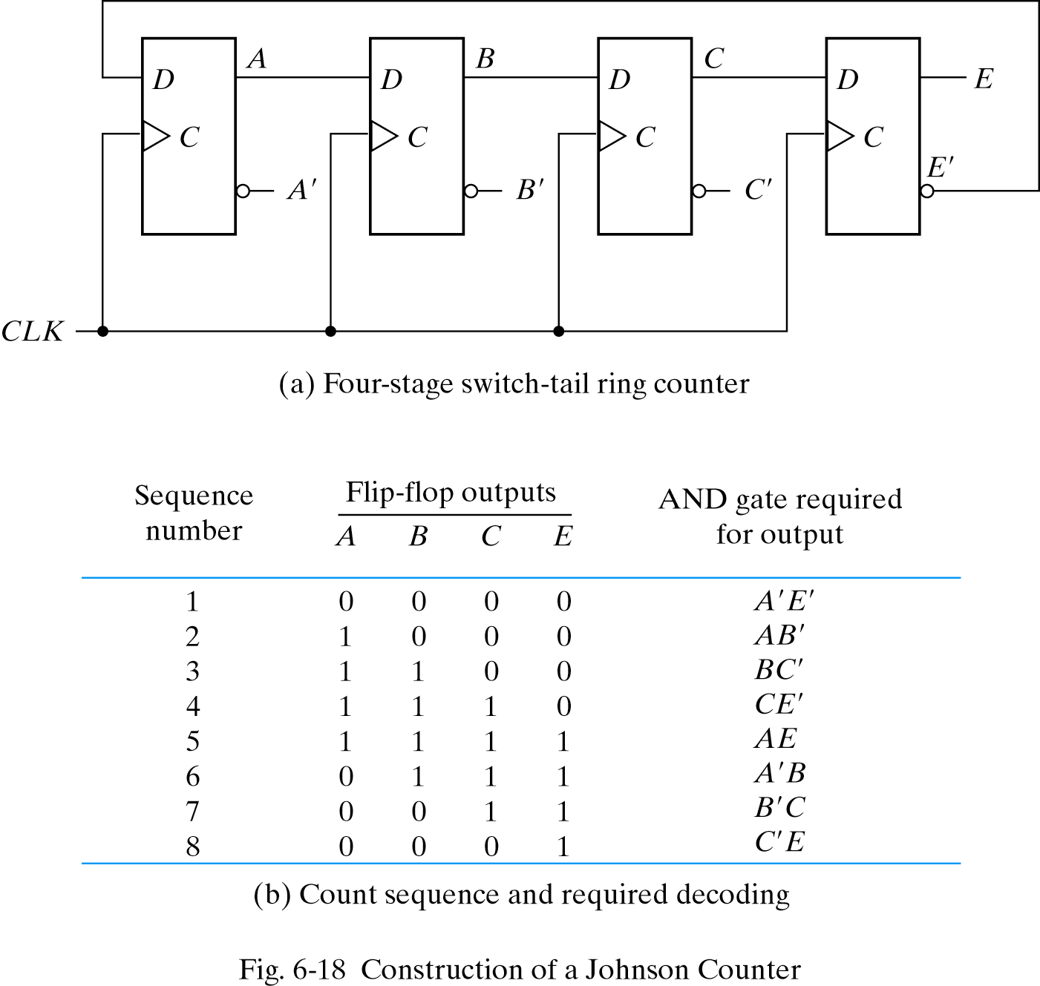
6.5 OTHER COUNTERS - Johnson Counter
A circular shift register with the complement output of the last flip-flop connected to the input of the first flip-flop.

Slide 27
6.6 HDL FOR REGISTERS AND COUNTERS - Shift Register
// Behavioral description of a 4-bit universal shift register
// Fig. 6.7 and Table 6.3
module Shift_Register_4_beh ( // V2001, 2005
output reg [3: 0] A_par, // Register output
input [3: 0] I_par, // Parallel input
input s1, s0, // Select inputs
MSB_in, LSB_in, // Serial inputs
CLK, Clear // Clock and Clear
);
always @ (posedge CLK, negedge Clear) // V2001, 2005
if (~Clear) A_par <= 4'b0000;
else
case ({s1, s0})
2'b00: A_par <= A_par; // No change
2'b01: A_par <= {MSB_in, A_par[3: 1]}; // Shift right
2'b10: A_par <= {A_par[2: 0], LSB_in}; // Shift left
2'b11: A_par <= I_par; // Parallel load of input
endcase
endmodule
module t_Shift_Register_4_beh ();
reg s1, s0, // Select inputs
MSB_in, LSB_in, // Serial inputs
clk, reset_b; // Clock and Clear
reg [3: 0] I_par; // Parallel input
wire [3: 0] A_par; // Register output
Shift_Register_4_beh M0 (A_par, I_par,s1, s0, MSB_in, LSB_in, clk, reset_b);
initial #200 $finish;
initial begin clk = 0; forever #5 clk = ~clk; end
initial fork
// test reset action load
#3 reset_b = 1;
#4 reset_b = 0;
#9 reset_b = 1;
// test parallel load
#10 I_par = 4'hA;
#10 {s1, s0} = 2'b11;
// test shift right
#30 MSB_in = 1'b0;
#30 {s1, s0} = 2'b01;
// test shift left
#80 LSB_in = 1'b1;
#80 {s1, s0} = 2'b10;
// test circulation of data
#130 {s1, s0} = 2'b11;
#140 {s1, s0} = 2'b00;
// test reset on the fly
#150 reset_b = 1'b0;
#160 reset_b = 1'b1;
#160 {s1, s0} = 2'b11;
join
endmodule

Slide 28
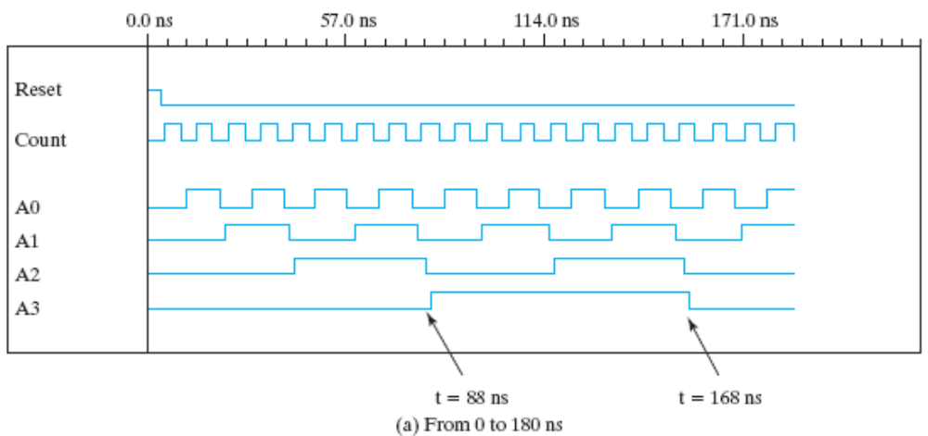
6.6 HDL FOR REGISTERS AND COUNTERS - Ripple Counter
`timescale 1ns / 100 ps
module Ripple_Counter_4bit (A3,A2,A1,A0, Count, Reset);
output A3,A2,A1,A0;
input Count,Reset;
//Instantiate complementing flip-flop
Comp_D_flip_flop F0 (A0, Count, Reset);
Comp_D_flip_flop F1 (A1, A0, Reset);
Comp_D_flip_flop F2 (A2, A1, Reset);
Comp_D_flip_flop F3 (A3, A2, Reset);
endmodule
//Complementing flip-flop with delay
//Input to D flip-flop = Q'
module Comp_D_flip_flop (Q, CLK, Reset);
output Q;
input CLK, Reset;
reg Q;
always @ (negedge CLK, posedge Reset)
if (Reset) Q <= 1'b0; else Q <= #2 ~Q;
// else젨Q <= #2 ~Q;젨젨?
endmodule
//Stimulus for testing ripple counter
module testcounter;
reg Count;
reg Reset;
wire A0,A1,A2,A3;
//Instantiate ripple counter
Ripple_Counter_4bit M0 (A3, A2, A1, A0, Count, Reset);
always
#5 Count = ~Count;
initial
begin
Count = 1'b0;
Reset = 1'b1;
#4 Reset = 1'b0;
end
initial
#200 $finish;
endmodule

Slide 29
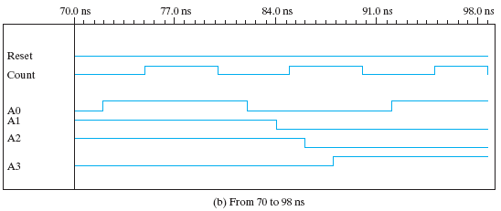
6.6 HDL FOR REGISTERS AND COUNTERS - Ripple Counter

